Slide 1

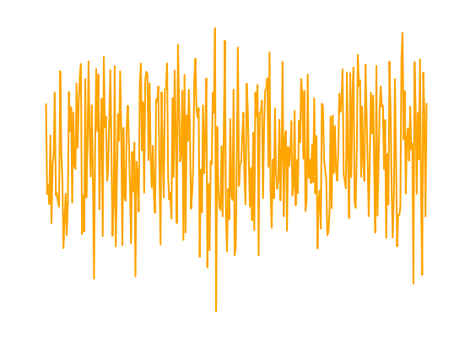

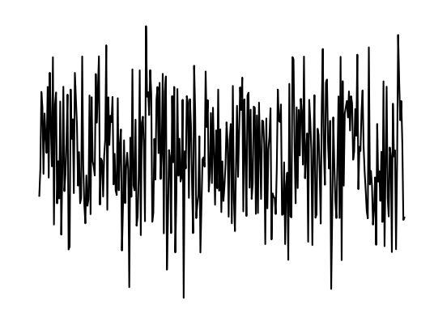


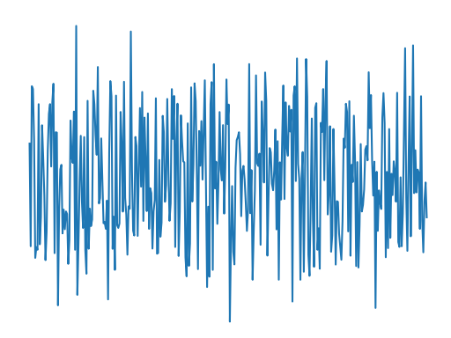
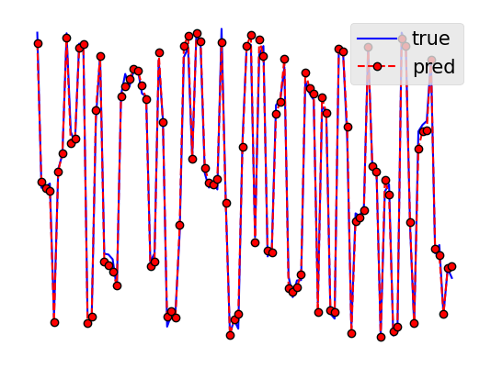
1
Data collection
2
Data Pre-processing
Real
CSI
Concatenate
Input data
CSI
CSI
Memory
CFR
Imag
Transmitter
Receiver
3
4
Model Evaluation
Model Training
Predictive Model
Evaluation Metrics
…
CNN
MAE
…
LSTM
…
RMSE
…
Prediction
…
Feature
…
Calculate
SGCS
Visualize
Informer
…
…
Label
Fine tuning
Label

